Slide 1
Software DESIGN Principles
COMP6100001 - Software engineering
Session 08
Kenny Jingga, S.Kom., M.T.

Slide 2
Session 08 – Software DESIGN Principles
Learning objectives
At the end of this session, students will be expected to be able to:
Understand the Role and Importance of Software Design Principles
Describe Key Software Design Principles, Including SOLID Principles
Explore the Basics of Interface and Experience Design

Slide 3
Session 08 – Software DESIGN Principles
Content outline
Introduction to design principles
SOLID principles
Applying principles to scenarios

Slide 4
Introduction to Software Design Principles
What is Software Design?
Definition:
  Software design is the process of defining the architecture, components, interfaces, and other characteristics of a system or component.
Purpose:
  Transform software requirements into a blueprint for constructing the software.
  Ensure that the software system meets specified requirements.
Key Points:
  Involves problem-solving and planning a software solution.
  Aims to produce a model or representation of the software system.

Slide 5
Interface and Experience Design
User Interface (UI) Design
Definition:
  The design of the interface through which users interact with software applications.
Principles:
  Clarity: Interfaces should be clear and unambiguous.
  Consistency: Uniform design elements across the application.
  Feedback: Provide users with feedback on their actions.
  Affordance: Design elements should suggest their functionality.

Slide 6
Interface and Experience Design
User Experience (UX) Design
Definition:
  The process of enhancing user satisfaction by improving usability and accessibility.
Principles:
  User-Centered Design: Focus on users' needs and preferences.
  Simplicity: Streamline user tasks to be as straightforward as possible.
  Accessibility: Ensure the interface is usable by people with varying abilities.

Slide 7
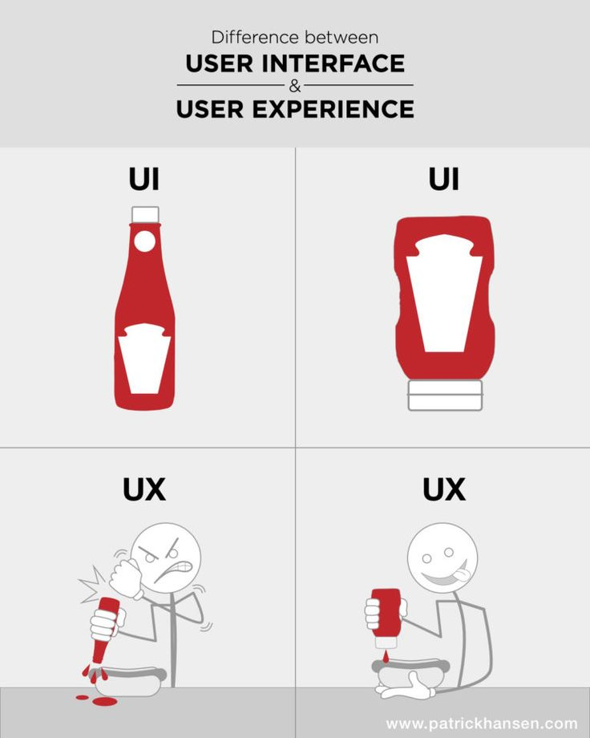

Slide 8

INTERFACE and Experience DESIGN
Typical design error
Easy to learn?
Easy to use?
Easy to understand?
lack of consistency
too much memorization
no guidance / help
no context sensitivity
poor response
Arcane/unfriendly

Slide 9
INTERFACE and Experience DESIGN
Eight GOLDEN RULEs of interface design
Strive for consistency
Enable frequent users to use shortcuts
Offer informative feedback
Design dialogue to yield closure
Offer simple error handling
Permit easy reversal of actions
Support internal locus of control
Reduce short-term memory load
https://www.interaction-design.org/literature/article/shneiderman-s-eight-golden-rules-will-help-you-design-better-interfaces

Slide 10
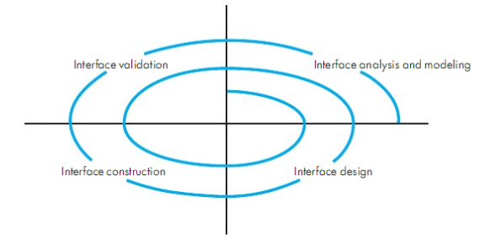
INTERFACE and Experience DESIGN
The user interface design process

Slide 11
INTERFACE and Experience DESIGN
Design Issues
Response time
Help facilities
Error handling
Menu and command labeling
Application accessibility
Internationalization

Slide 12
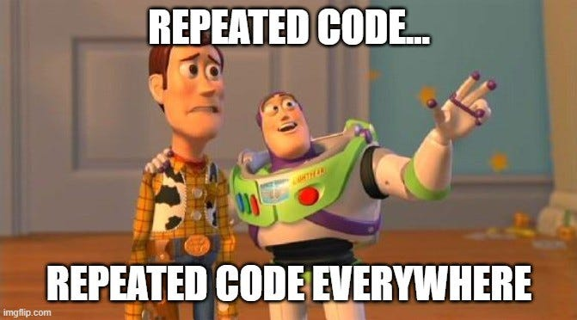
Fundamental Design Principles
DRY (Don’t Repeat Yourself)
Definition:
  Avoid duplication of code or functionality.
Benefits:
  Reduces maintenance efforts.
  Minimizes bugs due to inconsistent changes.
Example:
  Using functions or classes to encapsulate reusable code.

Slide 13
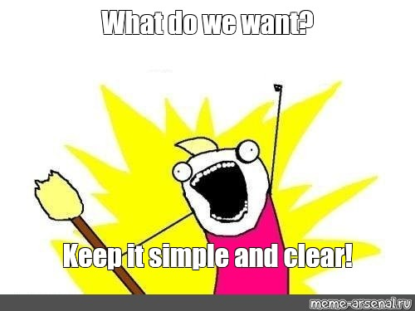
Fundamental Design Principles
KISS (Keep it Simple, Stupid)
Definition:
  Simplicity should be a key goal; unnecessary complexity should be avoided.
Benefits:
  Enhances readability and understandability.
  Simplifies debugging and maintenance.
Example:
  Choosing simple algorithms over complex ones when appropriate.

Slide 14
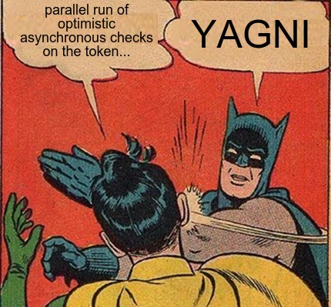
Fundamental Design Principles
YAGNI (You aren’t Gonna Need It)
Definition:
  Do not implement functionality until it is necessary.
Benefits:
  Saves time and resources.
  Prevents code bloat.
Example:
  Avoid adding features based on speculative future needs.

Slide 15
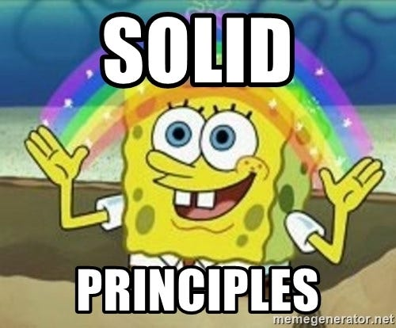
SOLID Principles
Overview
A set of five principles aimed at making object-oriented designs more understandable, flexible, and maintainable.
The Principles:
Single Responsibility Principle (SRP)
Open-Closed Principle (OCP)
Liskov Substitution Principle (LSP)
Interface Segregation Principle (ISP)
Dependency Inversion Principle (DIP)

Slide 16
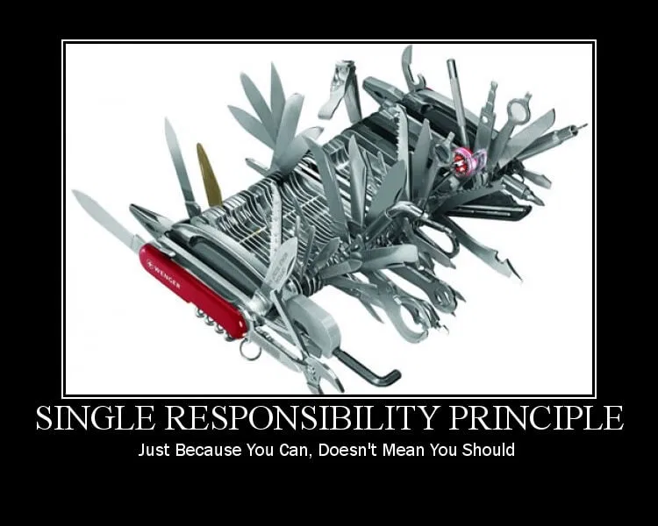
SOLID Principles
Single Responsibility Principle (SRP)
Definition:
  A class should have one, and only one, reason to change.
Benefits:
  Increases cohesion.
  Simplifies testing and maintenance.
Example:
  Separating data handling from user interface logic.

Slide 17
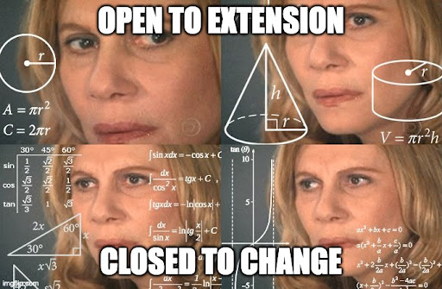
SOLID Principles
Open-closed Principle (OCP)
Definition:
  Software entities should be open for extension but closed for modification.
Benefits:
  Allows adding new features without changing existing code.
  Reduces the risk of introducing new bugs.
Example:
  Using abstract classes or interfaces to allow new implementations.

Slide 18
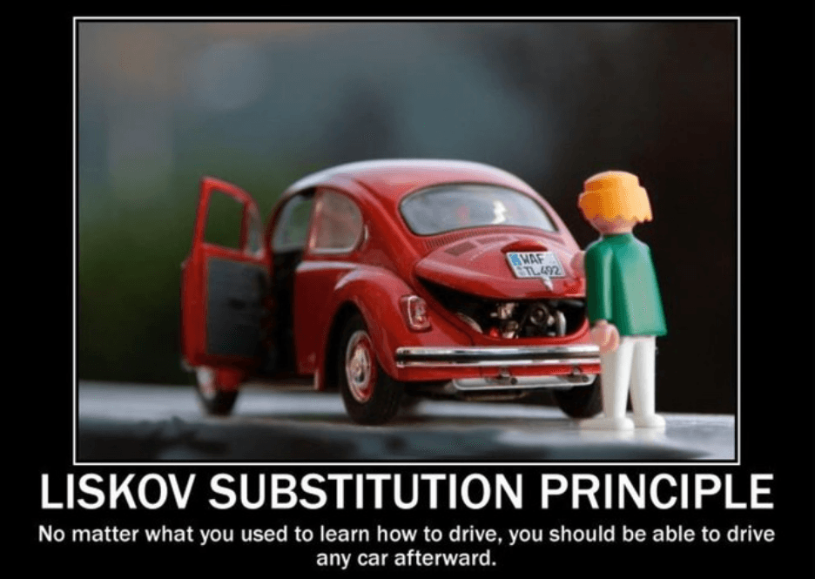
SOLID Principles
Liskov Substitution Principle (LSP)
Definition:
  Subtypes must be substitutable for their base types.
Benefits:
  Ensures that a subclass can stand in for its superclass without unexpected behavior.
Example:
  If class Square inherits from Rectangle, it should not alter expected behaviors.

Slide 19
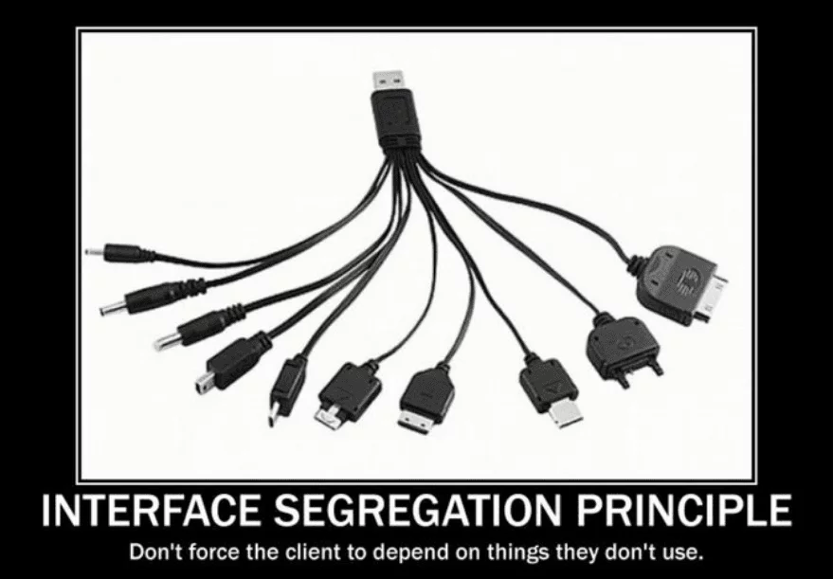
SOLID Principles
Interface Segregation Principle (ISP)
Definition:
  Clients should not be forced to depend on interfaces they do not use.
Benefits:
  Promotes decoupling.
  Reduces the impact of changes.
Example:
  Splitting a large interface into smaller, more specific ones.

Slide 20

SOLID Principles
Dependency Inversion Principle (DIP)
Definition:
  High-level modules should not depend on low-level modules; both should depend on abstraction.
Benefits:
  Enhances modularity and reusability.
  Simplifies testing through dependency injection.
Example:
  Depending on interfaces rather than concrete classes.

Slide 21
Applying Design Principles to Real-World Scenarios
Case Study: Online Shopping Platform
Scenario:
  Building an e-commerce website with user accounts, product listings, shopping carts, and order processing.
Application of Principles:
  SRP: Separate classes for User Management, Product Catalog, Shopping Cart, and Order Processing.
  OCP: Use interfaces for payment processing to allow adding new payment methods without altering existing code.
  DRY: Centralize input validation logic to avoid repetition.
  KISS: Simplify the checkout process to require minimal user steps.

Slide 22
References
Roger Pressman and Bruce Maxim. (2020). Software Engineering: A Practitioner's Approach. 9th. McGraw Hill. New York. ISBN: 978-1259872976.

